Slide 1
WELCOME TO MY Digital Portfolio
STUDENT NAME: Nivetha R
REGISTER NO AND NMID: EA183E6B2F4A4748EBD488291D83B83B
DEPARTMENT: BSC. Computer Science with Artificial Intelligence
COLLEGE: COLLEGE/ UNIVERSITY: SSKV College of Arts and Science for Women

Slide 2
PROJECT Title
1. Interruptive Digital Portfolio using Front-End Development.
2. HTML, CSS, and JavaScript works

Slide 3


AGENDA
Project Overview
Problem Statement
End Users
Tools and Technologies Used
Portfolio design and Layout
Features and Functionality
Results and Screenshots
Conclusion
Github Link
3/21/2024 Annual Review

Slide 4

PROJECT OVERVIEW
Project Title: Digital Portfolio Website.
Developed using HTML, CSS, JavaScript.
Designed to be responsive, interactive, navigation and user-friendly.
Helps present work in a creative and professional way.
Acts as a personal showcase platform for student projects & skills.

Slide 5

PROBLEM STATEMENT
Traditional project reports are text-heavy and unattractive.
Lack of an interactive platform to showcase skills and mini-projects.
Hard for teacher/evaluators to quickly understand student’s work.
Need for a unique and visually appealing way to present projects.
Digital Portfolio can solve this by presenting projects in a creative, structured, and interactive way.

Slide 6

WHO ARE THE END USERS?
Students - build & present portfolio projects.
Teachers/Faculty – evaluate projects in a format.
Employers/Recruiters – assess technical and creative skills.
Peers – share, collaborate, and learn from each other.

Slide 7

TOOLS AND TECHNIQUES
TOOLS:
HTML
CSS
JavaScript
VS Code
TECHNIQUES:
Responsive Web Design
CSS Flexbox & Hover Effects
JavaScript Interactivity (alerts, buttons, forms)
Structured Coding (HTML, CSS, JS kept separate

Slide 8
POTFOLIO DESIGN AND LAYOUT
Header with navigation bar
Hero section introducing the developer
About section with bio & skills
Projects section showcasing work
Contact section with form
Footer with credits
CSS Flexbox & Grid
Responsive Design
Hover & Animation Effects
8

Slide 9

FEATURES AND FUNCTIONALITY
FEATURES
Responsive & user-friendly interface
Attractive design with hover effects
Separate sections for About, Projects, and Contact
Gradient background
FUNCTIONALITY
Navigation bar for smooth movement across sections
Interactive “Say Hi” button using JavaScript
Contact form with input fields
Project cards with hover animations

Slide 10

RESULTS AND SCREENSHOTS
RESULTS:
Successfully created a responsive digital portfolio using HTML, CSS & JavaScript.
Portfolio includes sections: Home, About Me, Projects, Contact.
Navigation bar, hover effects, and contact form are working properly.
Portfolio looks creative, interactive, and user-friendly.
3/21/2024 Annual Review
10

Slide 11
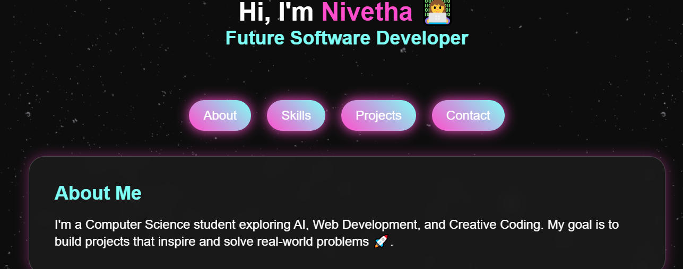
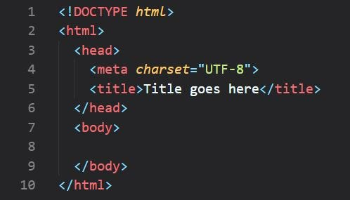
SCREENSHOTS:

Slide 12
CONCLUSION
The Digital Portfolio project was successfully developed using HTML, CSS, and JavaScript. It serves as a creative and user-friendly platform to showcase personal information, skills, and projects. This project helped me gain practical experience in web development and understand how to design an interactive website. In the future, this portfolio can be enhanced by adding advanced features such as dark mode, animations, and database integration.
12

Slide 13
THANK YOU

